Slide 1
LOAN PREDICTION
Introduction
Data understanding
Data analysis
Analysis and modelling
Summary of the project

Slide 2
INTRODUCTION
Problem statement:-
Here I need to predict the sanction of loan to
particular person by considering independent
variables .
In this project the bank loan prediction is done by using either logistic regression or decision tree model
Here iam considering 13 variables on which we are predicting the analysis

Slide 3
DATA UNDERTSTANDING
Iam considering gender,load id ,married status,education,self employed,applicants income,loan amount,credit history,dependent,
Coapplicants income,loan amount term,property area,loan status as my attributes to this project
Based on this attributes iam performing linear regression analysis and random forest analysis for this problem

Slide 4
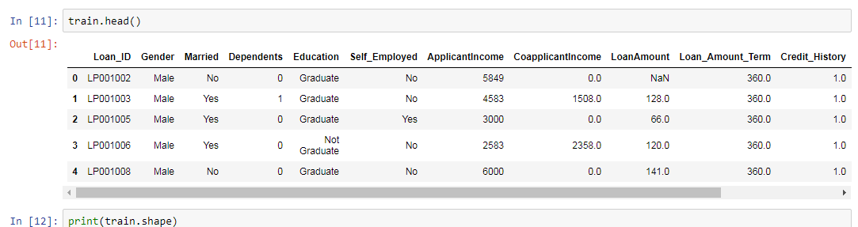
ATTRIBUTES

Slide 5
Analysis and modelling
Iam performing linear regression and random forest for the analysis iam taking x,y variables
Where y is always a target variable which we have to determine the accuaracy rate for this we training the data and testing it when we fit x and y variables in fit test iam getting accuracy rate of 0.81
When performing random forest test iam getting accuracy rate of 0.82 so for me I will prefer random forest because of betterment than other

Slide 6
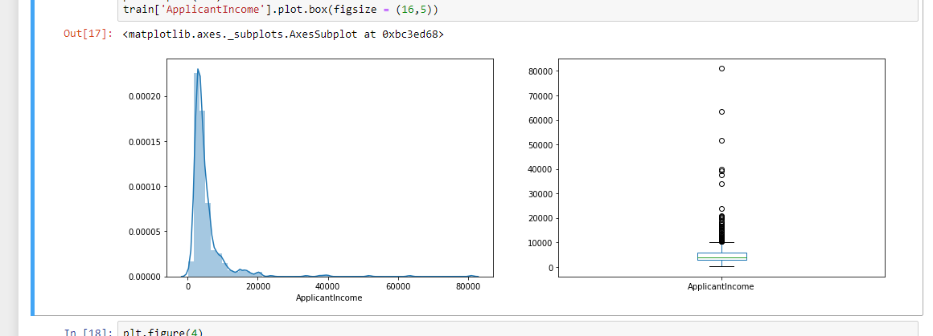

Slide 7
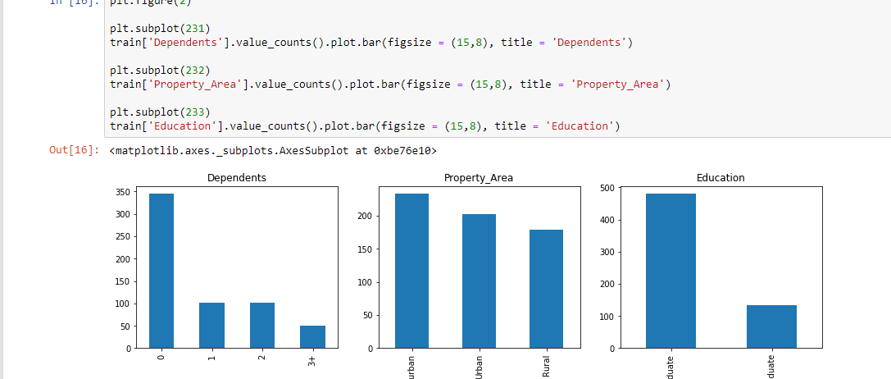

Slide 8
AGE
GENDER
LOAN ID
EDUCATION BACK GROUND ……
ATTRIBUTES
LOGISTIC REGRESSION
DECISION TREE
MODEL
ACCURACY RATE 0.81
ACCURACY RATE 0.82

Slide 9
Summary
I am importing fuctions from the different libraries such as pandas,numpy.etcand now by considering all attributes.iam reading the data from particular location . iam performing different functions like head(),describe(), on it.here some of the functions are in the categorical values and iam converting them in to the numerical values

Slide 10
By using label encoder function() I am plotting the different sub graphs by using the function sub plot which iam exporting from sea born library iam training the data set and am fitting the data .and performing test analysis on it finally iam applying logistic regression and decision tree to check the accuracy .depending on the best accuaracy iam choosing best suitable method to choose the model

Slide 11
COCLUSION
HOW CAN ORGANIZATION WILL BENEFIT??
WHY I CHOOSEN THE DECISION TREE MODEL FOR THIS??
WHAT ARE LEARNINGS FROM THE PROJECT?
THANK U

